Slide 1
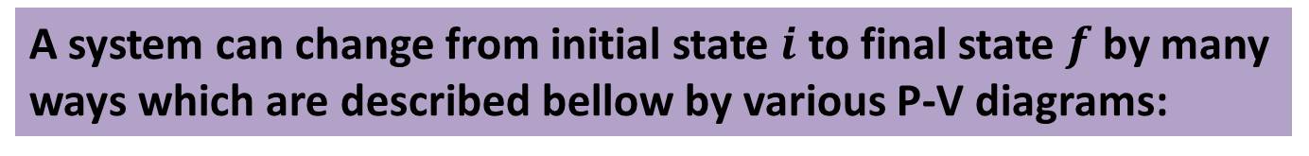
Evaluation of Work Done by P-V Diagram
A system can change from initial state $i$ to final state $f$ by many ways which are described bellow by various P-V diagrams:
1.
Here, the pressure decreases as volume increases.
So, the work done is positive.

Slide 2
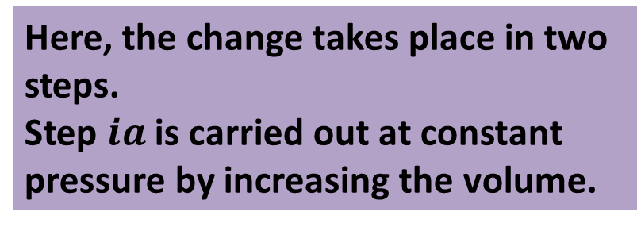

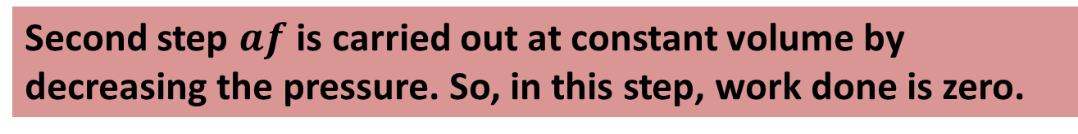
2.
Here, the change takes place in two steps.
Step $ia$ is carried out at constant pressure by increasing the volume.
So, positive work is done in this step.
Second step $af$ is carried out at constant volume by decreasing the pressure. So, in this step, work done is zero.
For the overall process, work done is positive and is carried out only during step $ia$

Slide 3
3.
Here, the change also takes place in two steps.
First step is carried out at constant volume by decreasing the pressure. So, in this step, work done is zero.
Second step is carried out at constant pressure by increasing the volume. So, positive work is done in this step.
For the overall process, work done is positive and is carried out only during the second step.

Slide 4
4.
Here, the pressure increases as volume decreases.
So, the work done is negative.

Slide 5
Here, the system is taken from some initial state i to some other state f and then back to i. The net work done by the system during the cycle is the sum of the positive work done during the expansion and the negative work done during the compression.
5.
The net work is positive because the area under the expansion curve (i to f ) is greater than the area under the compression curve (f to i).

Slide 6
In the previous situations, both W and Q depend on the nature of the process but the quantity Q-W is the same for all process which depends only on the initial and final states, not on the process.
First Law of Thermodynamics: “The energy can neither be created nor destroyed, it can only change forms.”
If we produce △Q heat to a system and some part of it does △W work on the system then rest of the heat will change the internal energy ,△E of the system.
In the form of an equation, the 1st Law is
△Q= △W+ △E

Slide 7
First law of Thermodynamics in Four Thermodynamic Processes
Adiabatic processes: In an adiabatic process, no transfer of heat occurs between the system and its environment.
Putting △Q =0 in the first law: △E=- △W
Thus if work is done on the system, the internal energy increases and if work is done by the system, the internal energy of the system decreases.

Slide 8
Constant-volume processes: If the volume of a system is held constant, that system can do no work.
Putting △W= 0 in the first law: △E=△Q
Thus, if heat is absorbed by a system, the internal energy increases and if heat is lost, the internal energy of the system decrease.

Slide 9
Cyclical processes: In this process, after certain interchanges of heat and work, the system is restored to its initial state. Thus the internal energy does not change.
Putting △E =0 in the first law: △Q = △W
Thus, the net work done must be equal to the net transferred heat.

Slide 10
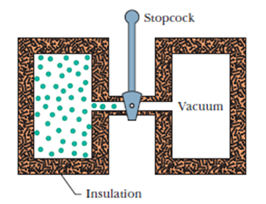
Free Expansion: These are the adiabatic processes in which no transfer of heat occurs between the system and its environment and no work is done on or by the system.
Thus, △Q = △W= 0 and the first law becomes: △E=0

Slide 11
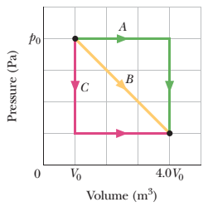
43. In Fig., a gas sample expands from V₀ to 4.0V₀ while its pressure decreases from p₀ to p₀/4.0. If V₀ = 1.0 m³ and p₀ = 40 Pa, how much work is done by the gas if its pressure changes with volume via (a) path A, (b) path B, and (c) path C?

Slide 12
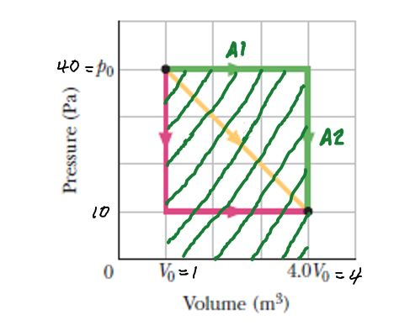

Solution of 43
W =$\int{dW}$ = $\int_{Vi}^{Vf}{pdV }$= Area under the curve of p-V
(a) W_{A} = W_{A1} + W_{A2}
W_{A1} = 40 (4-1) = 120 J
(constant pressure)
W_{A2} = 0 (constant volume)
W_{A} = 120 +0 = 120 J

Slide 13
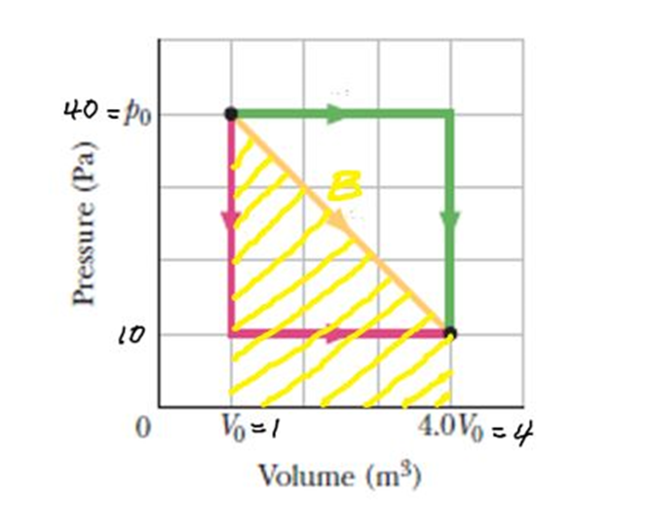
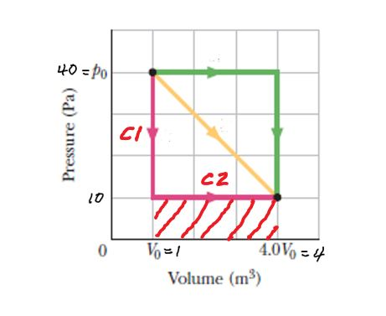
(b) The work done by the gas is the area
under the curve (yellow line)
W_{B}= ½ ×(4 - 1)(40 -10) + (4 -1)(10 - 0)
= 75 J
(c) W_{C}= W_{C1} + W_{C2}
W_{C1} = 0 (constant volume)
W_{C2} = 10 (4 - 1) = 30 J
W_{C} = 0 + 30 = 30 J

Slide 14
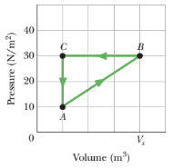
45. A gas within a closed chamber undergoes the cycle shown in the p-V diagram of Fig. The horizontal scale is set by V_{s} = 4.0 m³. Calculate the net energy added to the system as heat during one complete cycle.

Slide 15
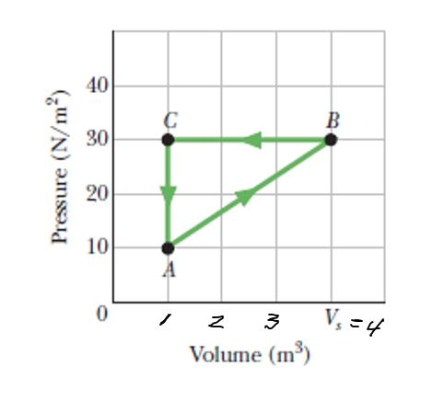
Solution of 45
The work done by the gas from A to B
W_{AB}= ½ ×(4 - 1)(30 -10) + (4 -1)(10 - 0) = 60 J
The work done by the gas is from B to C,
W_{BC}= (30 -0) × (1-4)= -90 J
The work done by the gas is from C to A,
W_{CA}= 0
So the total work done, W= 60 J-90J+0=-30 J
Since for a closed cycle, ΔE_{int} = 0
1st law of thermodynamics, ΔE_{int} = Q - W
0 = Q - W
Q = W = - 30 J
The gas loses heat.

